Slide 1

P.R.PATIL COLLEGE OF ENGINEERING
Guide Project Coordinator HOD
(Prof. A.D.Chokhat) (Prof. F.M.shelke) ( Prof. P.D.Soni)

Slide 2
“Health Care”
A Minor Project Synopsis
on
Presented By:
Sarvesh R. Dakhane
Rohit G. Khandare
Roshan V. Padmane
Shubham D. Futhane

Slide 3
INTRODUCTION
We all know the importance of good health that’s why we decide to make this project.
In our project , we are focus on patient health and fitness.
We are providing information to patient about health tips like exercise ,diet etc.
All the information is base on the patient disease and their physical health.
We are trying to keep patient healthy and fit by natural way.

Slide 4
EXISTING SYSTEM
Considering allopathic medicines , this are very costly.
Due to allopathic medicine some time , we face different problem like allergy. It cure the disease but with some drawbacks .
Taking allopathic medicine regularly ,our body goes addict to that medicine.
People are addict to this medicine and avoiding the exercise and not take their meal properly.

Slide 5
PROPOSED SYSTEM
Proper exercise keep a man away from disease, high cholesterol and blood pressure.
Diet are different for every person but good diet plan improve your health .
Regular Exercise increase your stamina and keep your body fit.
Instead of using allopathic medicine .we must try natural way to cure disease.

Slide 6
Analysis
In our project, we are try to cover all basic disease and their prevention using exercise and diet.
At the time of registration form for login , patient must want to fill the details about patients (Weight, height , age ...etc).
We are providing all the health tips according to patients physical health.

Slide 7
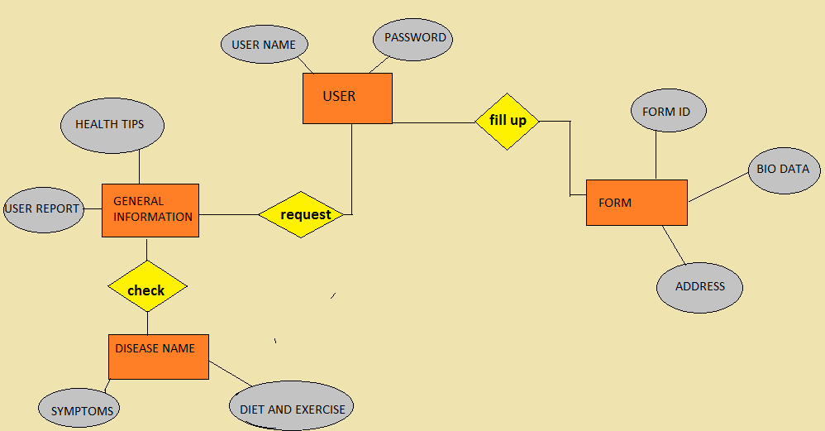
ER DIGRAM

Slide 8
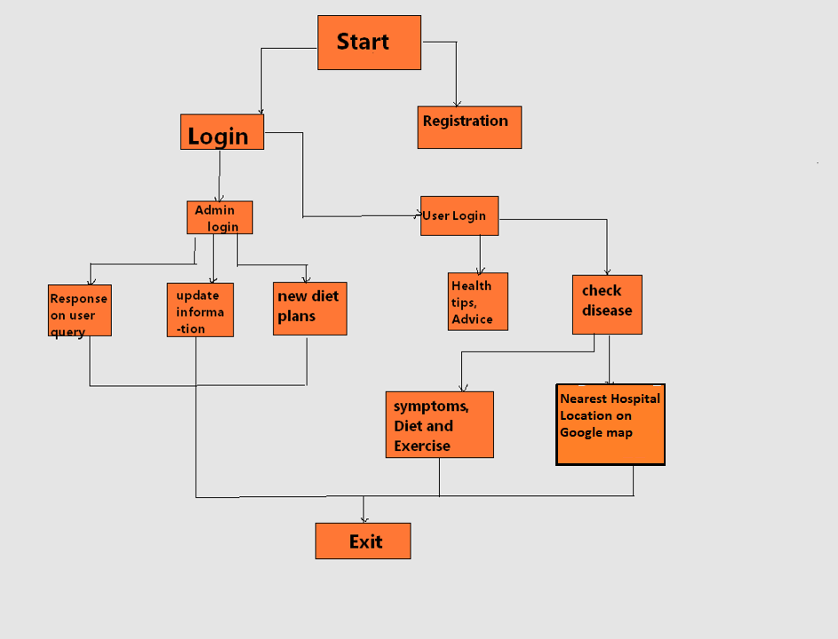
PROPOESD DFD

Slide 9
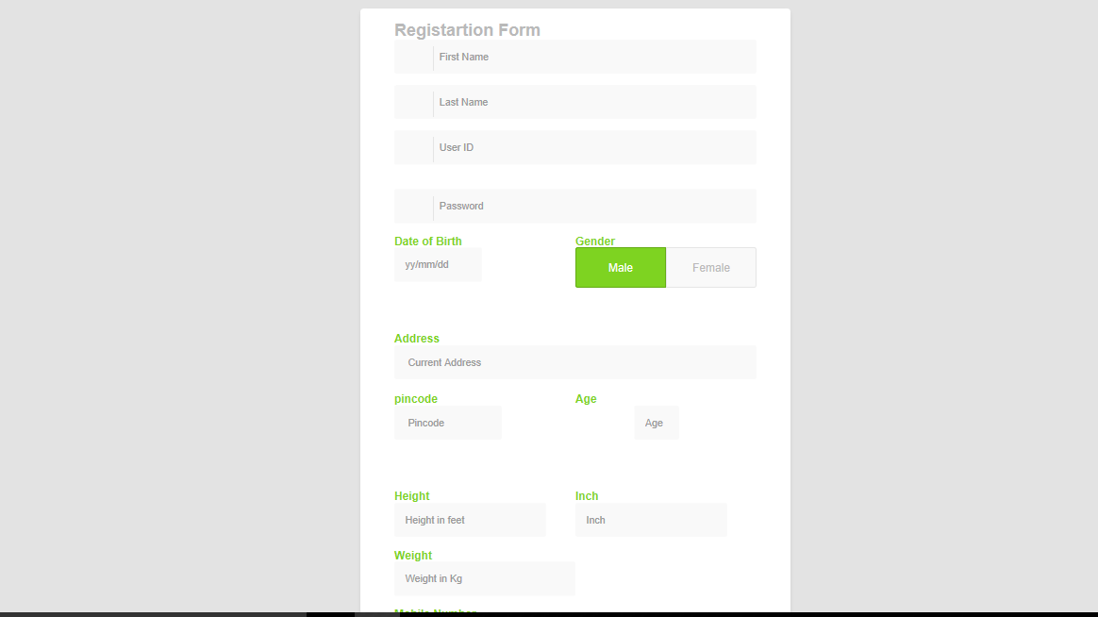
Registration Form

Slide 10
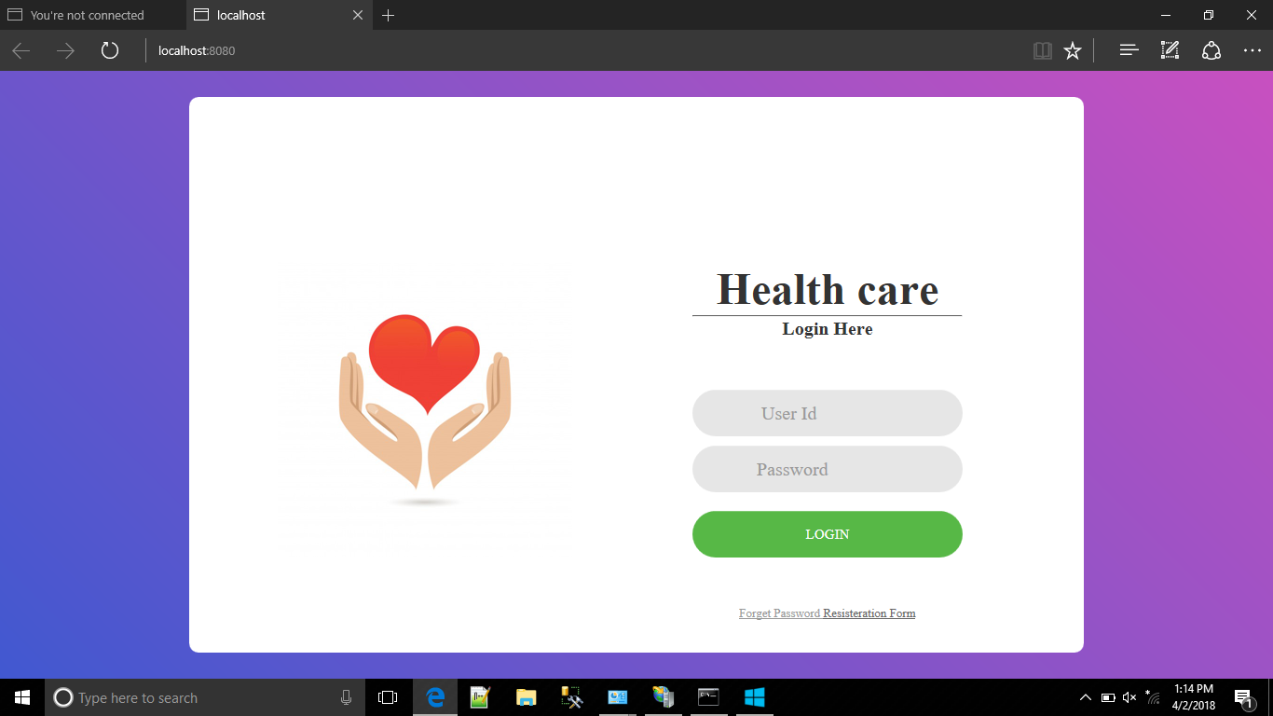
Login Page

Slide 11
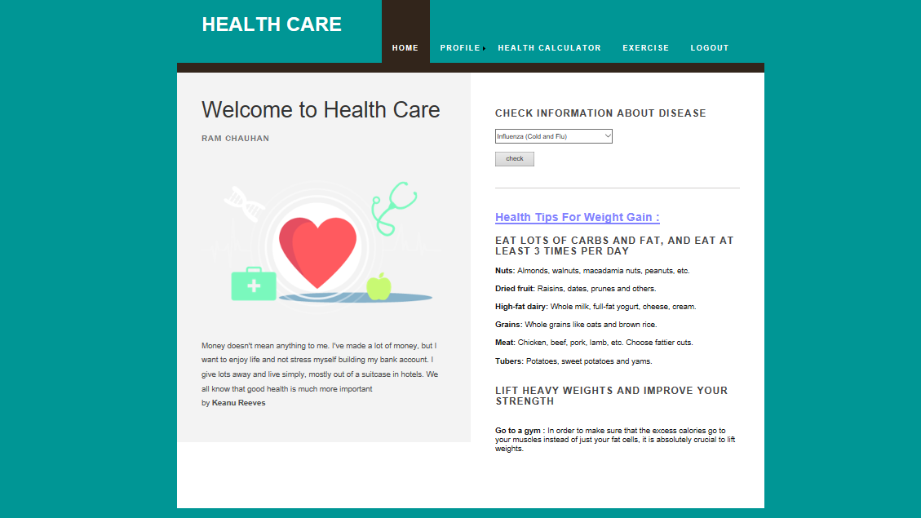
Patient Home Page

Slide 12
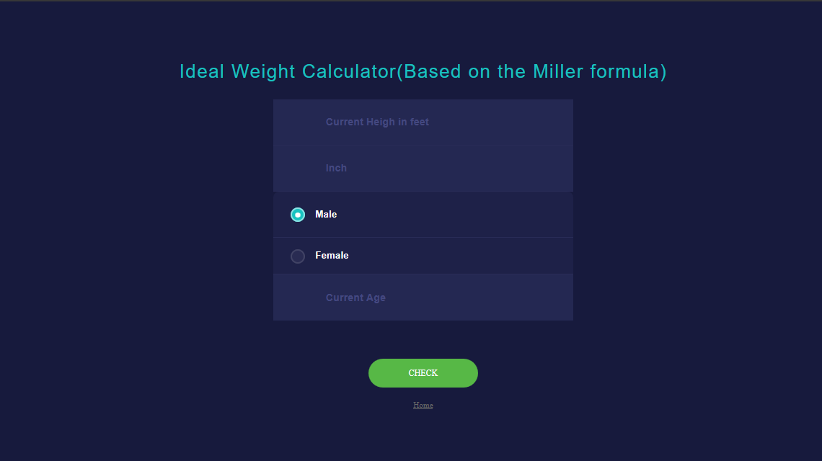
Health Calculator

Slide 13
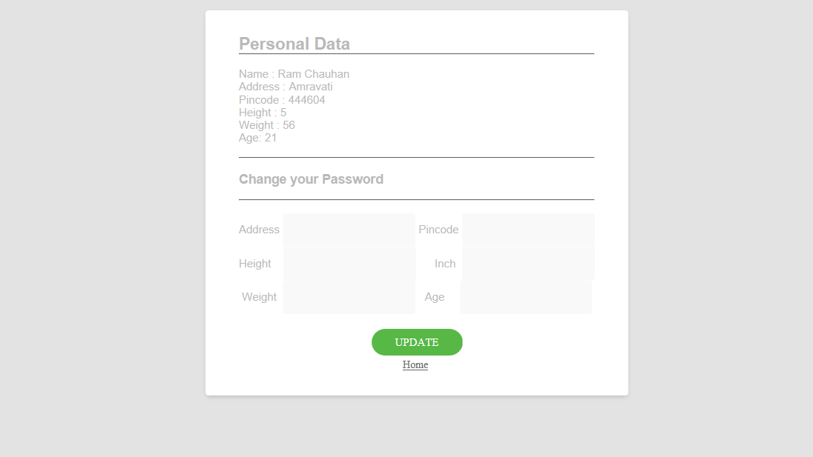
Update Data

Slide 14
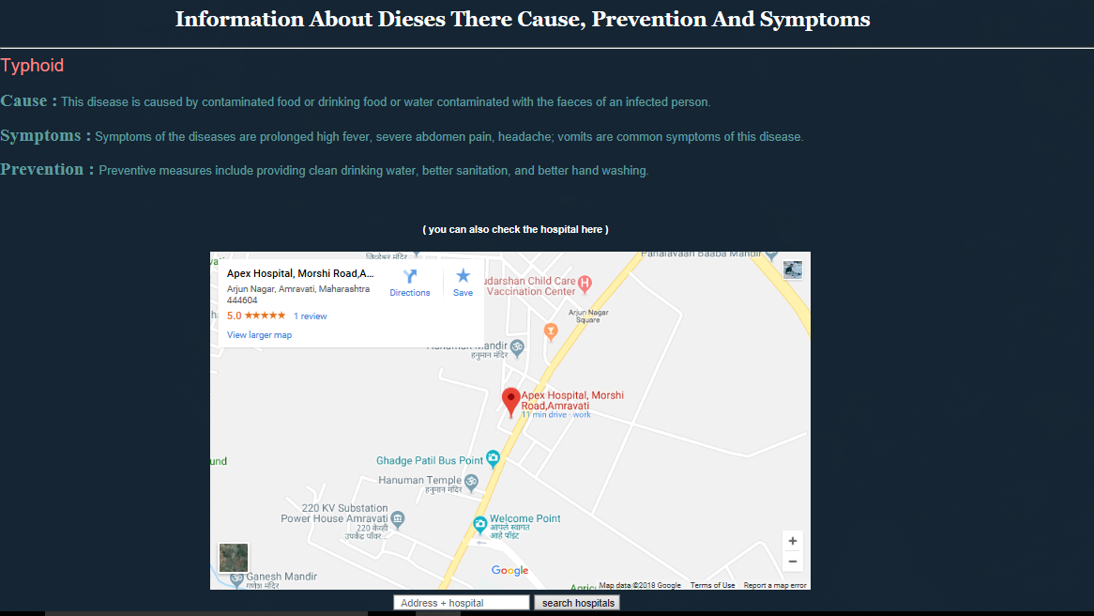
Nearest Hospital

